Slide 1
Airline industry Overview
Review of Accidents and Industry Financials
Angie Oehler
Task 2

Slide 2
Overview
Topics to cover:
Accident overview
Types of accidents
Airfare overview
Industry overview

Slide 3
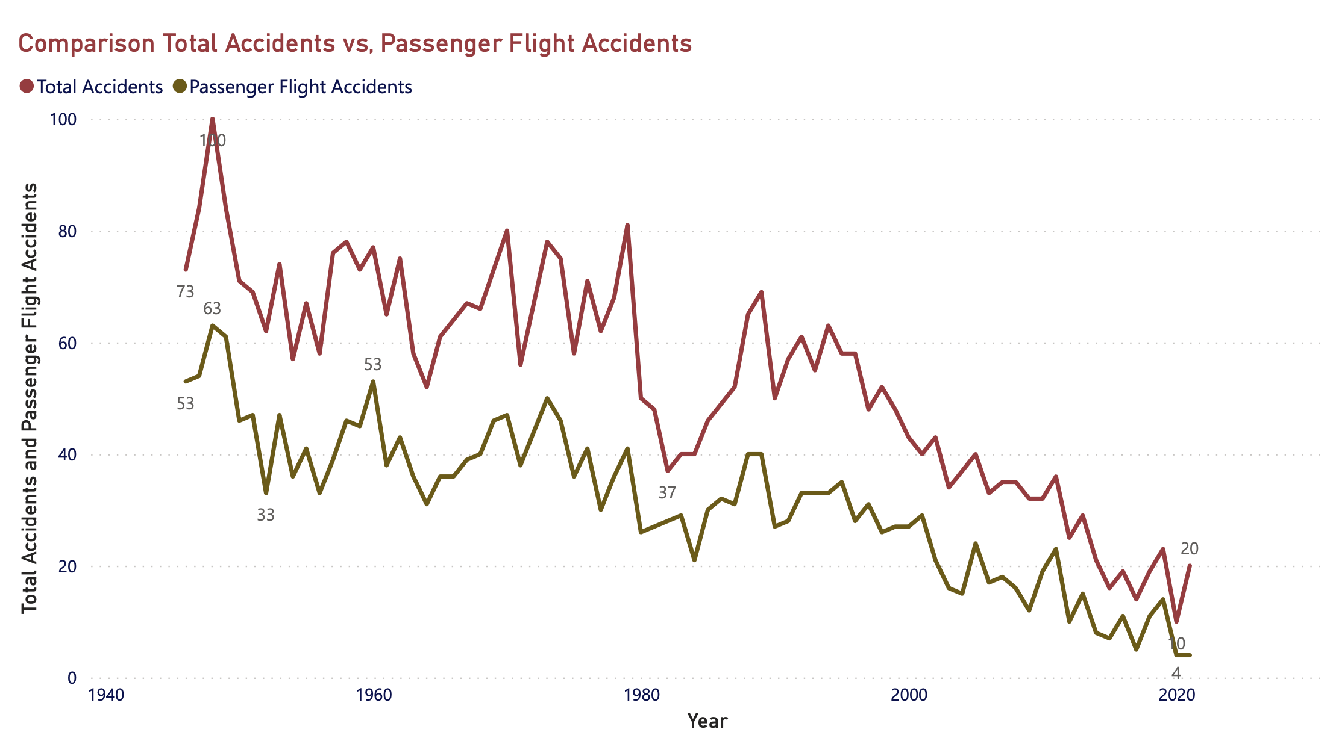
Total accidents vs Passenger craft accidents
Crashes down across both categories
Fluctuates year to year, but overall trend is down
Mid-90’s sharp decrease/increase of total accidents not as highly represented in passenger craft accidents
Around 2010 the two groups begin moving closer together

Slide 4
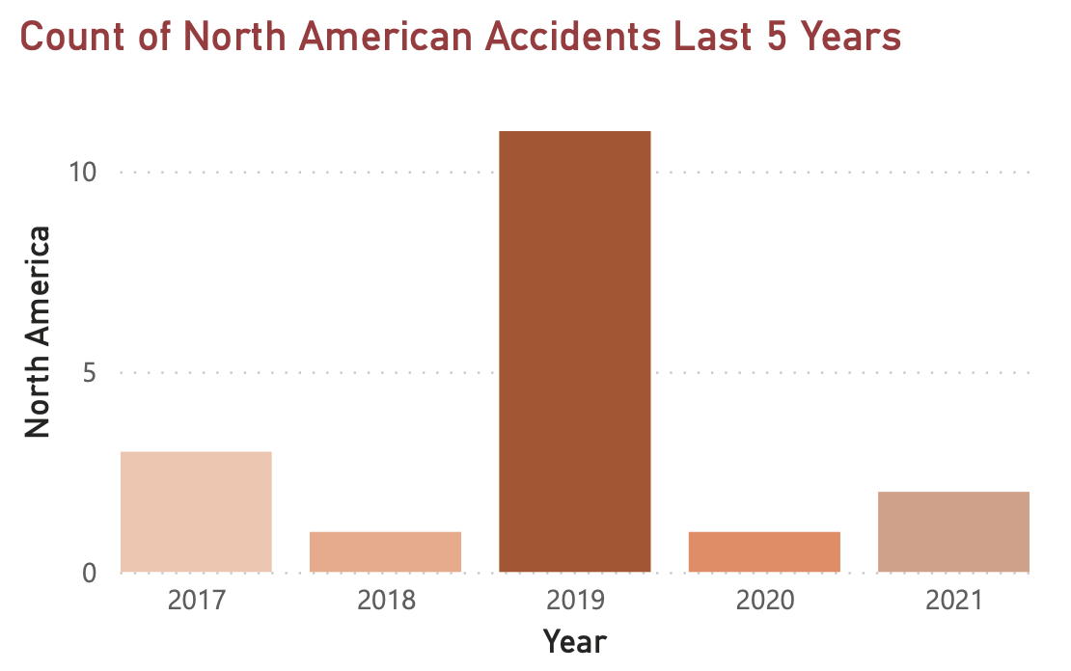
Accidents last 5 years
Closer look at the last five years of accidents
Narrows focus to North America
2019 peak as seen in previous chart
North American accidents about 1/3 of worldwide accidents
2021 slight increase as number of flights increase post – 2020.

Slide 5
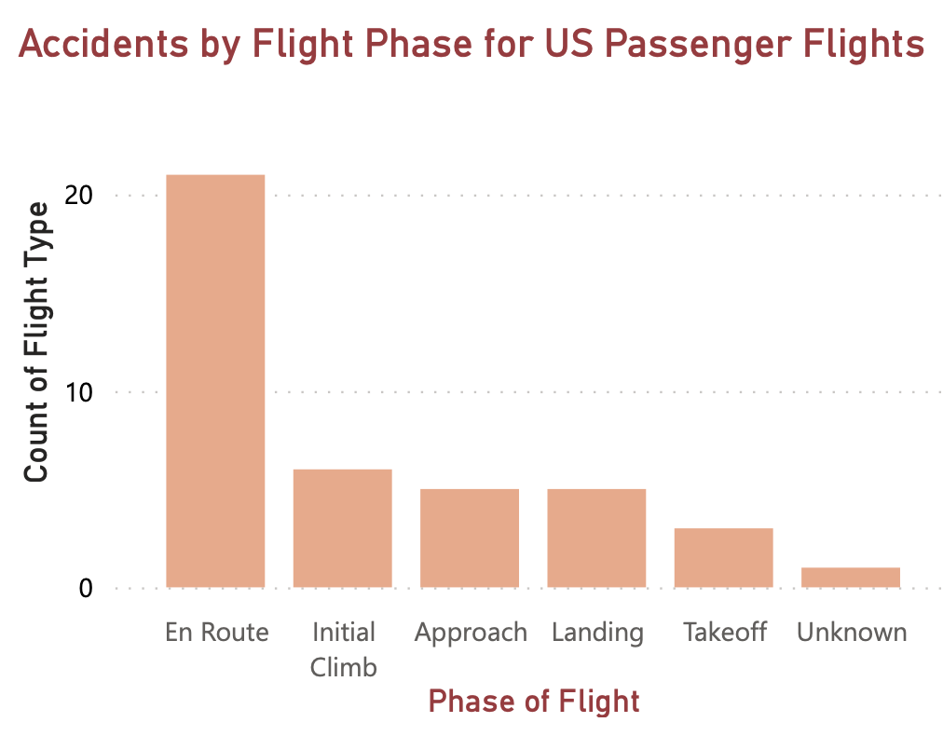
Safety Focus – US passenger flights
Each phase of flight comes with risks
Some phases riskier than others
Explore where/when “En Route” accidents occur
Takeoff and Initial climb 2nd greatest risk when combined
Approach/Landing risks equal
Recommend additional research
Weather?
Time of day?
Aircraft?
Length of flight?
Etc.

Slide 6
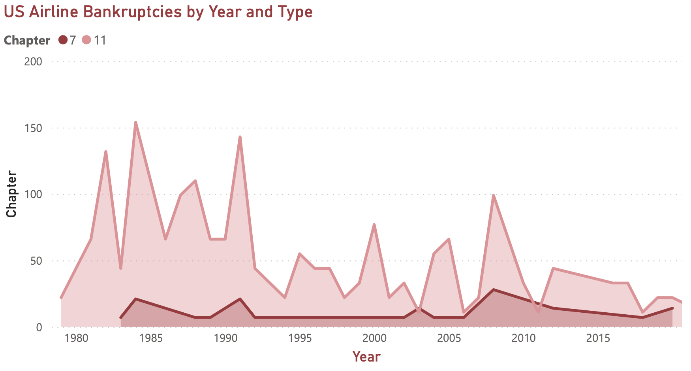
Financials - industry
Overview US Airline Bankruptcies
Volatile mid-80’s – mid 90’s
Chapter 11 common vs Chapter 7
Appears to be a 5 year peak/decline cycle

Slide 7
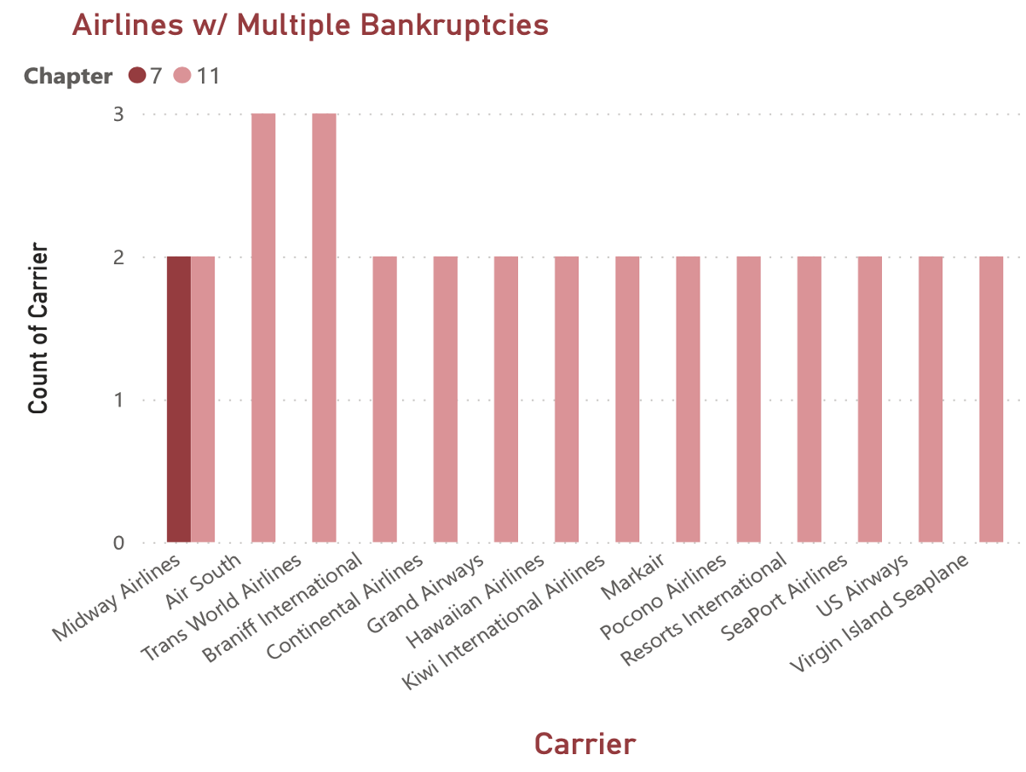
Financials - industry
All airlines with multiple bankruptcies fly internationally
Only Midway has both chapter 7 and 11
Most multiple filers have filed twice
Consider continue US-only flight model until new safety measures initiated and realized

Slide 8
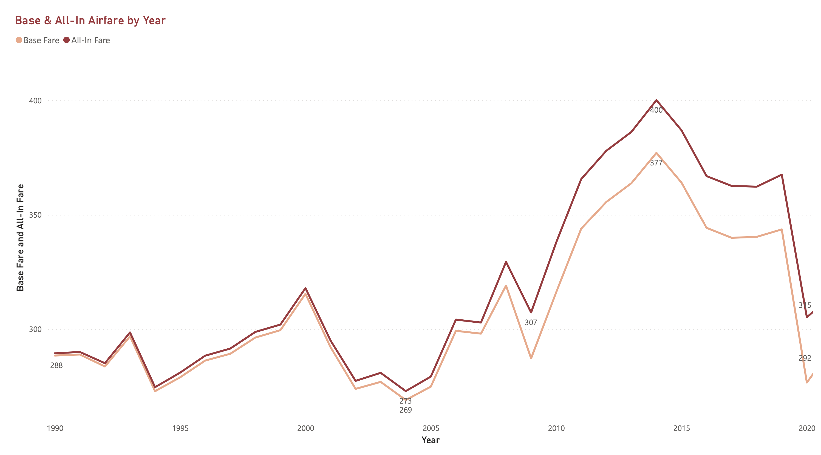
Financials - Airfares
Comparison of base fare rate and fare including taxes/fees
Two fares close until mid-2000’s
As rates increase, gap increases
Trend looks to continue post-2020
Great fluctuation in airfares over time
Sharp decline post-911, but recovered with a few years
Greatest decline in 2020
Looks to recovering and expect trend to continue

Slide 9
Thank you

